Slide 1

MAULANA AZAD NATIONAL INSTITUTE OF TECHNOLOGY, BHOPAL
BIOMETRIC SYSTEM FOR IDENTIFICATION USING EEG SIGNALS
PREPARED BY:
SAUHARD PAREEK (191112237)
SAMYAK MEHTA (191112213)
CHEERLA SAI KRUSHEEL (191112259)
KRISHNA KANT GOYAL (191112275)
UNDER THE GUIDANCE OF
DR. MITUL K. AHIRWAL
Department of CSE

Slide 2
Contents
Biometric
Biometric Modality
Characteristics Of Biometric Modality
EEG As Biometric Modality
Literature Review
Gaps Identified
Dataset Description
Dataset Arrangement
Class Balancing and Up-sampling
System Overview
Train-Test Split
CNN Architecture
Comparing Loss and Accuracy
Confusion Matrix
Average Training, Validation and Testing Accuracies
Results and Parameters
Conclusions
References
Department of CSE

Slide 3
Biometric
With the advent of technology, the human being has become more vulnerable in terms of security.
Strengthening of the security using the advanced technologies is the need of the hour.
Biometric, a one such security system, mainly deal with problems of authentication and identification [1].
Authentication is all about verifying that is the claimant one it really claims to be [1].
This makes authentication a binary class classification problem [1].
In identification, the system tries to know the identity of the claimant [1].
This makes identification a multi-class classification problem [1].
Biometric modality is measured for authentication and identification.
Department of CSE

Slide 4
Biometric Modality
Variety of biometric modalities like fingerprint, iris, face have been used in biometric systems [2].
Biometric modalities are the characteristics of an individual which uniquely identifies him[3].
These characteristics can be either physical or behavioral [3].
The physical biometric modalities need not require the subject to perform any specific activity [3].
While, the behavioral biometric modalities usually requires the subject to perform activities [3].
The physical modalities are affected by the interaction of the subject in front of the sensor [3].
This makes behavioral modality superior to physical modality [3].
Be it physical modality or behavioral modality, every biometric modality must have certain characteristics [3].
Department of CSE

Slide 5
Characteristics Of Biometric Modality
Universality – Every individual must posses these characteristics [3].
Distinctiveness - It must be different for 2 different individuals[4].
Permeance – The characteristics should not a vary a lot over a period of time[5].
Collectability – Acquisition process must be simple [3].
Performance – The performance for the required application must be acceptable and the other factors required should be affordable [3].
Acceptability – It should be accepted by the participants [3].
Circumvention– The characteristic must be robust to attacks[5].
Department of CSE

Slide 6
EEG As Biometric Modality
Finger-print, irises and voice etc. are popularly used as biometric modality but, they are vulnerable to attacks as the features can be extracted from high quality audio, video or image etc[3].
EEG, can be used as biometric modality as they are a difficult target for attack due to their dependence on person’s mental states [2].
EEG is highly affected by the stress, so it can also be used to know if the client is under threat [3].
Thus, EEG may provide vast amount of application if used as biometric modality.
EEG requires very less amount of memory in comparison to image based biometric modalities like finger-print [3].
EEG, if used in combination with other biometric modality, will result in enhanced performance [3].
EEG provides high temporal resolution and are less expensive in comparison to other neuro-imaging techniques[5].
Department of CSE

Slide 7
Literature Review
Using CNN-LSTM for user identification, in [2] for 16 channels the authors were able to achieve 99.58% accuracy and 0.41% equal error rate for 16 channels. However, their accuracy fell down to 94.28% when they used the proposed architecture on the data of selected 4 channels.
In [6], both user identification and authentication has been performed leveraging the ability of CNN to extract features and have used Manhattan distance as matching algorithm. However, they have used resting state data .
In [3], it has been suggested to consider the use of RMS spatial pattern as feature vector for user identification. They have built Neural network classifier which used radial basis and continuous tan, sigmoid activation function.
In [7], identification accuracy of 88% have been achieved using the proposed CNN model on resting state data for 10 subjects. They, also suggested that temporal threshold that can identify the subjects can be less than 200ms.
Department of CSE

Slide 8
Gaps Identified
The user identification using Electro encephalogram as biometric modality, is idea which is vastly unexplored.
Most of the studies which have been carried out on user identification have limited themselves to the use of machine learning for identification.
This approach requires features to be extracted manually which usually do not generalize well to all the new data.
So, the use of CNN for feature extraction could help us to solve this issue of generalization.
The studies that have used deep learning architecture for the identification, has limited themselves to resting state data usually.
Our aim is to perform user identification using CNN model and explore effect of different type of auditory stimuli in user identification.
Department of CSE

Slide 9
Dataset Description
Data was collected through 4 electrodes which were placed at P4, F8, Cz and T7 positions.
The subjects sat in relaxed state on a chair. Recording for an individual subjects were performed in a single day.
The EEG signal acquisition was done, one, in relaxed state for 3 sessions with eyes open and closed and other, with auditory stimuli.
For auditory stimulation, two types of ear phone were used, one, bone-conducting headphone and other, in-ear headphone.
The signal acquisition for each headphone was performed in 3 conditions, depending upon the type of audio subject were made to listen, which were neutral music, native song and non-native song.
The data provided consist of 2 minutes of recording involving least amount of noise [1].
Department of CSE

Slide 10
Dataset Arrangement
For each experiment, one file consists of data recorded through one channel for a subject.
As suggested in [1], we took the temporal threshold as 4 seconds.
As sampling frequency is 200Hz, so the effective instance size becomes 800.
The dimensions of each such file was (instance, 801) where last column represents class label.
User 1 has been assigned label 0, user 2 has been assigned label 1, and so on and so forth.
Since, there are 20 subjects, so we have 20 classes.
The effective instance count for a subject is 30 mostly, with exceptions in few cases.
Department of CSE

Slide 11
Instances before Up-sampling
Table1.SUBJECT-WISE INSTANCE COUNT FOR ALL EXPERIMENTS
 | In ear-native (Exp-5) | In ear-non native (Exp-6) | In ear neutral (Exp-7) | Bone conducting native (Exp-8) | Bone conducting non native (Exp-9) | Bone conducting neutral (Exp-10)
S01 | 30 | 30 | 30 | 30 | 30 | 30
S02 | 30 | 30 | 30 | 30 | 30 | 30
S03 | 30 | 29 | 55 | 30 | 30 | 30
S04 | 30 | 30 | 30 | 30 | 30 | 30
S05 | 50 | 30 | 30 | 30 | 30 | 30
S06 | 30 | 30 | 30 | 30 | 30 | 30
S07 | 30 | 30 | 30 | 30 | 30 | 30
S08 | 30 | 30 | 30 | 30 | 30 | 30
S09 | 30 | 30 | 30 | 30 | 30 | 30
S10 | 30 | 30 | 30 | 30 | 30 | 30
S11 | 30 | 30 | 30 | 30 | 30 | 30
S12 | 30 | 30 | 30 | 30 | 30 | 30
S13 | 30 | 30 | 30 | 30 | 30 | 30
S14 | 30 | 30 | 30 | 30 | 30 | 30
S15 | 30 | 30 | 30 | 30 | 30 | 30
S16 | 30 | 30 | 30 | 30 | 30 | 30
S17 | 30 | 30 | 30 | 30 | 30 | 30
S18 | 30 | 30 | 30 | 30 | 30 | 35
S19 | 30 | 30 | 30 | 30 | 30 | 30
S20 | 30 | 30 | 30 | 30 | 30 | 30

Slide 12
Class Balancing and Up-sampling
For balancing the classes, original instances were traversed in order and for each instance a new instance is generated by adding the gaussian to the original instance.
The noise is not added completely; instead, it is multiplied by a value called the multiplicative value.
This multiplicative value is less than 0.5, and then added to the original sample. The multiplicative value, here, used is 0.2.
After balancing the class, up-sampling is performed.
This is done by generating the gaussian noise and adding it to the original sample.
The noise is not added completely; instead, it is multiplied by a value called the multiplicative value, which here is less than 0.5, and then added to the original sample.
Since, the total number of new samples generated by this process for a sample is 10, out of which 5 are generated with multiplicative value 0.2 and rest with value 0.3.

Slide 13
System Overview
The biometric system consists of two phases:
Enrollment phase: In enrollment phase, the EEG biometrics of all 20 user’s are learned, trained and stored in Convolutional neural network.
Development/Identification phase: In identification phase, the identity of the person to whom the EEG recording belongs is returned as output.
Testing phase/Authentication phase: In authentication phase, the identity of a person attempting to access the service is returned.

Slide 14
Train-Test Split
Then, the data was split into training and testing in ratio 0.25. The training data was then further split into final training data and validation data with ratio 0.3.
Table2. TRAINING, TEST AND VALIDATION DATA
 | Training Dataset | Validation Dataset | Testing Dataset
Experiment 05 | 5768 | 2472 | 2760
Experiment 06 | 3458 | 1482 | 1660
Experiment 07 | 6342 | 2718 | 3040
Experiment 08 | 3458 | 1482 | 1660
Experiment 09 | 3458 | 1482 | 1660
Experiment 10 | 4032 | 1728 | 1940
Department of CSE

Slide 15
CNN Architecture
Table3.TRAINING, TEST AND VALIDATION DATA
Type of Layer | Output Shape | Other Parameters of each layer
Conv1D Batch Normalization Max Pooling 1D | (793;64) (793;64) (791;64) | Filters - 64, Kernel Size - 8, Pool Size – 3, Activation - Relu
Conv1D Batch Normalization Max Pooling 1D | (784;128) (784;128) (782;128) | Filters - 128, Kernel Size - 8, Pool Size – 3, Activation - Relu
Conv1D Batch Normalization Max Pooling 1D | (775;256) (775;256) (773;256) | Filters - 256, Kernel Size - 8, Pool Size – 3, Activation - Relu
Flatten Dense Dense Output | (197888) (64) (64) (20) | Units - 64, Activation – Relu Units - 64, Activation – Relu Units - 20, Activation – SoftMax
Department of CSE

Slide 16
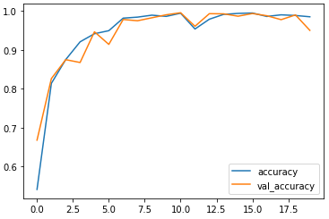
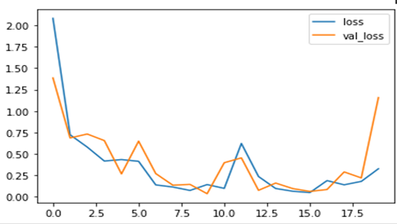
Comparing Loss and Accuracy
Fig1. Comparing Accuracy and Val_Accuarcy for Experiment 5
Fig2. Comparing Loss and Val_Loss for Experiment 5
Department of CSE

Slide 17
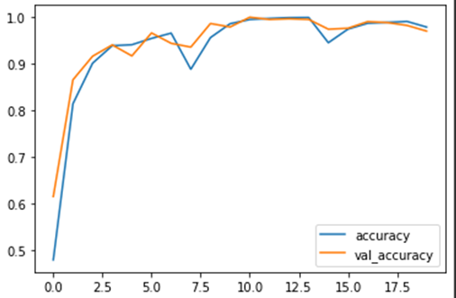
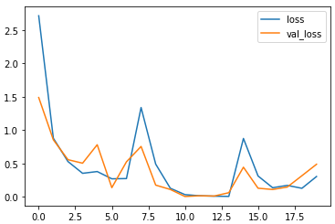
Comparing Loss and Accuracy
Fig3. Comparing Accuracy and Val_Accuarcy for Experiment 6
Fig4. Comparing Loss and Val_Loss for Experiment 6
Department of CSE

Slide 18
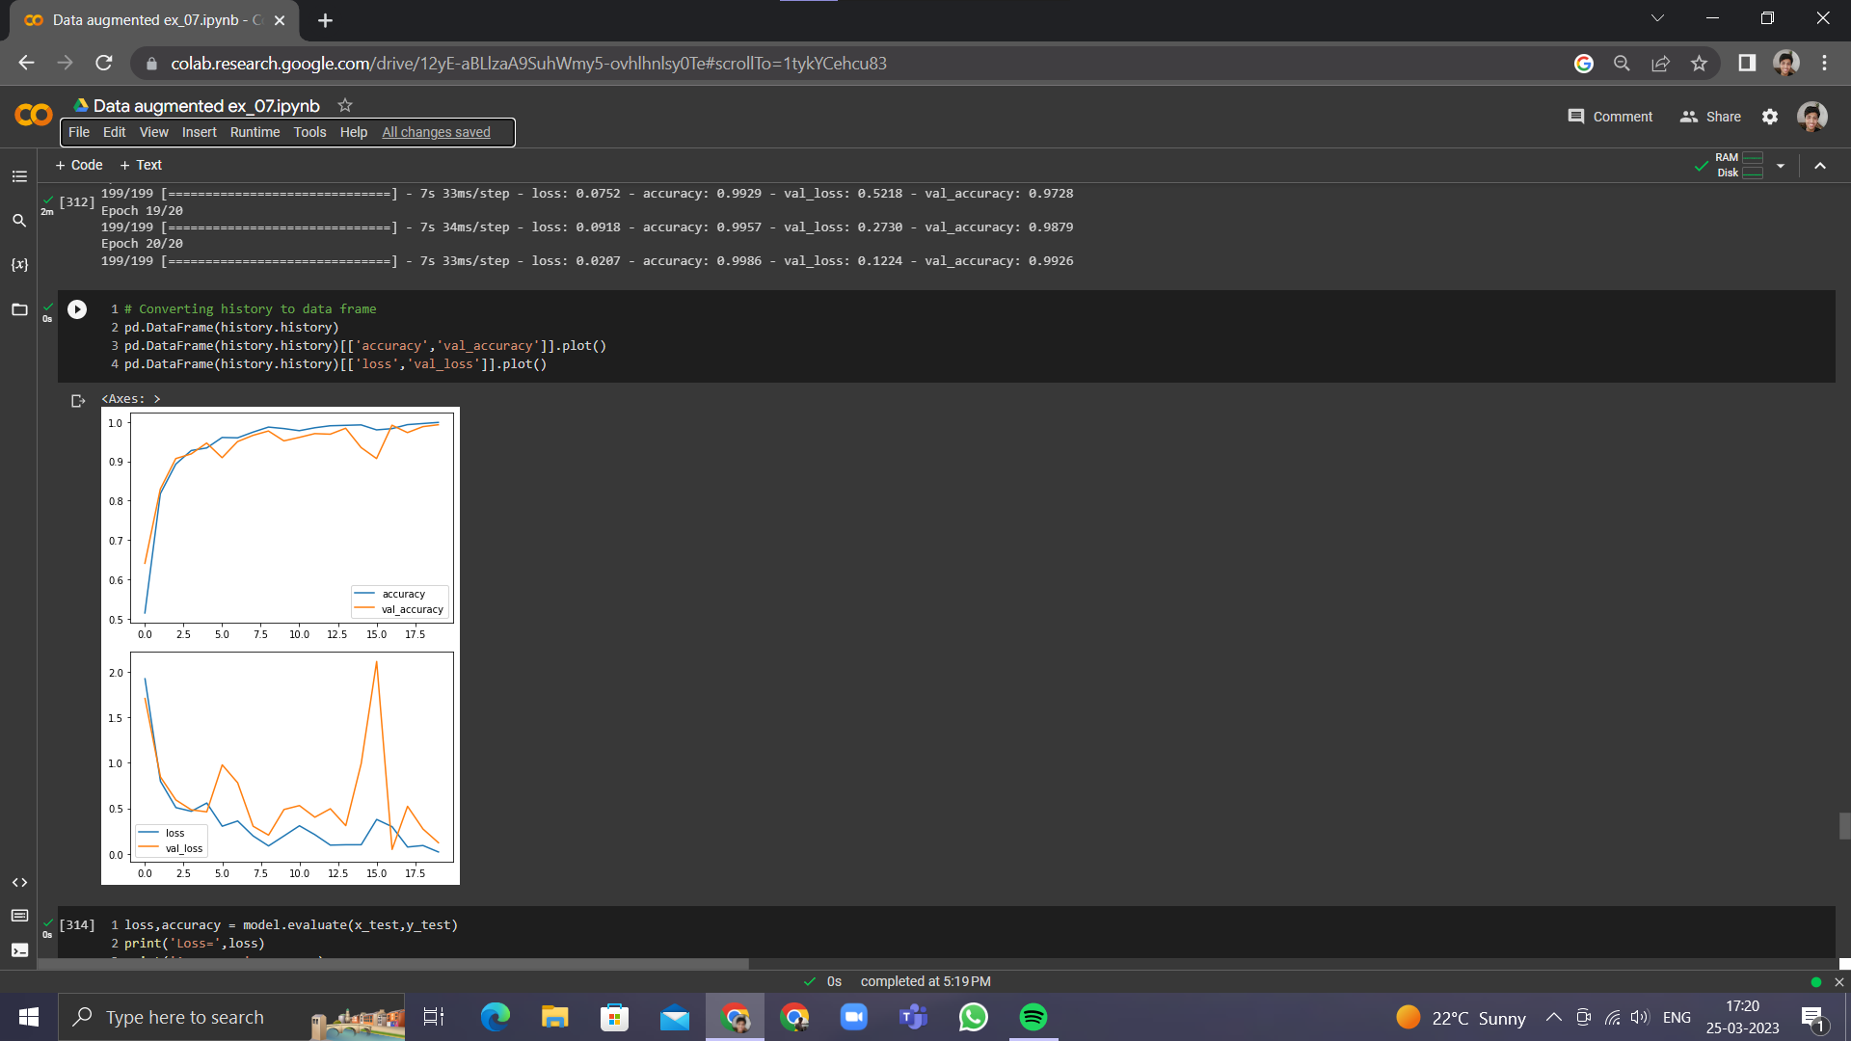

Comparing Loss and Accuracy
Fig5. Comparing Accuracy and Val_Accuarcy for Experiment 7
Fig6. Comparing Loss and Val_Loss for Experiment 7
Department of CSE

Slide 19
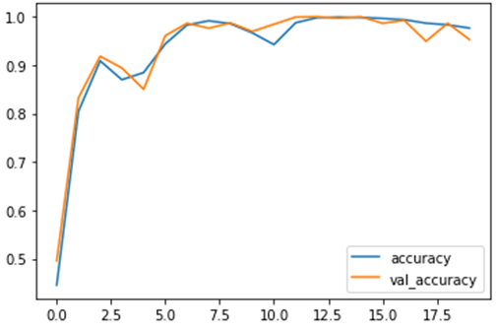
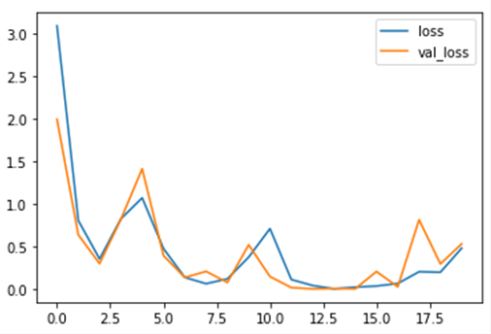
Comparing Loss and Accuracy
Fig7. Comparing Accuracy and Val_Accuarcy for Experiment 8
Fig8. Comparing Loss and Val_Loss for Experiment 8
Department of CSE

Slide 20
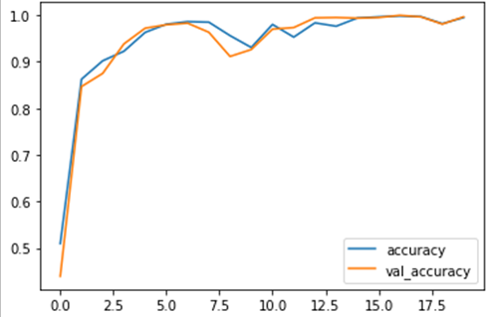
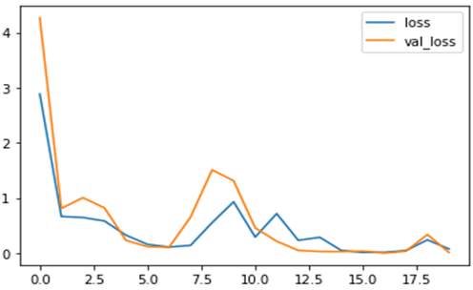
Comparing Loss and Accuracy
Fig9. Comparing Accuracy and Val_Accuarcy for Experiment 9
Fig10. Comparing Loss and Val_Loss for Experiment 9
Department of CSE

Slide 21
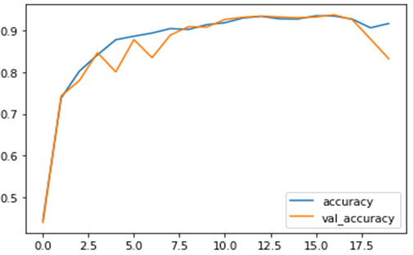
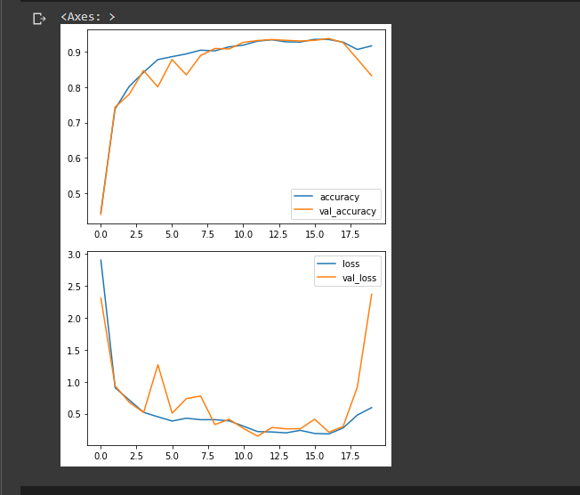
Comparing Loss and Accuracy
Fig11. Comparing Accuracy and Val_Accuarcy for Experiment 10
Fig12. Comparing Loss and Val_Loss for Experiment 10
Department of CSE

Slide 22
Confusion Matrix
Table4. CONFUSION MATRIX FOR EXPERIMENT 5
 |  | PREDICTED
 |  | S01 | S02 | S03 | S04 | S05 | S06 | S07 | S08 | S09 | S10 | S11 | S12 | S13 | S14 | S15 | S16 | S17 | S18 | S19 | S20
A C T U A L | S01 | 111 | 0 | 0 | 0 | 0 | 0 | 0 | 0 | 0 | 0 | 0 | 0 | 0 | 0 | 0 | 18 | 0 | 0 | 9 | 0
 | S02 | 0 | 135 | 0 | 0 | 0 | 0 | 0 | 0 | 0 | 0 | 0 | 0 | 0 | 0 | 0 | 0 | 0 | 0 | 3 | 0
 | S03 | 0 | 0 | 138 | 0 | 0 | 0 | 0 | 0 | 0 | 0 | 0 | 0 | 0 | 0 | 0 | 0 | 0 | 0 | 0 | 0
 | S04 | 0 | 0 | 0 | 138 | 0 | 0 | 0 | 0 | 0 | 0 | 0 | 0 | 0 | 0 | 0 | 0 | 0 | 0 | 0 | 0
 | S05 | 0 | 0 | 0 | 0 | 138 | 0 | 0 | 0 | 0 | 0 | 0 | 0 | 0 | 0 | 0 | 0 | 0 | 0 | 0 | 0
 | S06 | 1 | 4 | 0 | 0 | 0 | 127 | 0 | 0 | 0 | 6 | 0 | 0 | 0 | 0 | 0 | 0 | 0 | 0 | 0 | 0
 | S07 | 4 | 0 | 0 | 0 | 0 | 0 | 130 | 0 | 0 | 0 | 0 | 1 | 3 | 0 | 0 | 0 | 0 | 0 | 0 | 0
 | S08 | 0 | 0 | 0 | 0 | 0 | 0 | 0 | 138 | 0 | 0 | 0 | 0 | 0 | 0 | 0 | 0 | 0 | 0 | 0 | 0
 | S09 | 0 | 0 | 0 | 0 | 0 | 0 | 0 | 0 | 134 | 0 | 0 | 4 | 0 | 0 | 0 | 0 | 0 | 0 | 0 | 0
 | S10 | 0 | 0 | 0 | 0 | 0 | 0 | 0 | 8 | 5 | 124 | 1 | 0 | 0 | 0 | 0 | 0 | 0 | 0 | 0 | 0
 | S11 | 0 | 0 | 0 | 0 | 0 | 0 | 0 | 0 | 0 | 0 | 138 | 0 | 0 | 0 | 0 | 0 | 0 | 0 | 0 | 0
 | S12 | 1 | 0 | 0 | 0 | 0 | 0 | 0 | 0 | 0 | 0 | 0 | 127 | 0 | 0 | 0 | 0 | 0 | 0 | 10 | 0
 | S13 | 0 | 0 | 0 | 0 | 0 | 0 | 0 | 0 | 0 | 0 | 0 | 4 | 134 | 0 | 0 | 0 | 0 | 0 | 0 | 0
 | S14 | 7 | 9 | 0 | 0 | 0 | 0 | 0 | 0 | 0 | 0 | 0 | 0 | 0 | 120 | 0 | 1 | 0 | 1 | 0 | 0
 | S15 | 0 | 0 | 0 | 0 | 6 | 0 | 0 | 0 | 0 | 3 | 0 | 0 | 0 | 0 | 129 | 0 | 0 | 0 | 0 | 0
 | S16 | 0 | 0 | 0 | 0 | 0 | 0 | 0 | 0 | 0 | 0 | 0 | 0 | 0 | 0 | 0 | 138 | 0 | 0 | 0 | 0
 | S17 | 0 | 0 | 0 | 0 | 0 | 0 | 0 | 0 | 0 | 0 | 0 | 0 | 0 | 0 | 0 | 0 | 138 | 0 | 0 | 0
 | S18 | 0 | 0 | 0 | 0 | 0 | 0 | 0 | 0 | 0 | 0 | 0 | 0 | 4 | 0 | 0 | 0 | 0 | 134 | 0 | 0
 | S19 | 0 | 0 | 0 | 0 | 0 | 0 | 0 | 0 | 0 | 0 | 0 | 0 | 0 | 0 | 0 | 0 | 0 | 0 | 138 | 0
 | S20 | 0 | 0 | 0 | 0 | 0 | 0 | 0 | 0 | 0 | 0 | 0 | 0 | 0 | 0 | 0 | 0 | 0 | 0 | 0 | 138

Slide 23
Confusion Matrix
Table5. CONFUSION MATRIX FOR EXPERIMENT 6
 |  | PREDICTED
 |  | S01 | S02 | S03 | S04 | S05 | S06 | S07 | S08 | S09 | S10 | S11 | S12 | S13 | S14 | S15 | S16 | S17 | S18 | S19 | S20
A C T U A L | S01 | 78 | 0 | 0 | 0 | 0 | 0 | 5 | 0 | 0 | 0 | 0 | 0 | 0 | 0 | 0 | 0 | 0 | 0 | 0 | 0
 | S02 | 0 | 83 | 0 | 0 | 0 | 0 | 0 | 0 | 0 | 0 | 0 | 0 | 0 | 0 | 0 | 0 | 0 | 0 | 0 | 0
 | S03 | 0 | 0 | 81 | 2 | 0 | 0 | 0 | 0 | 0 | 0 | 0 | 0 | 0 | 0 | 0 | 0 | 0 | 0 | 0 | 0
 | S04 | 0 | 0 | 0 | 83 | 0 | 0 | 0 | 0 | 0 | 0 | 0 | 0 | 0 | 0 | 0 | 0 | 0 | 0 | 0 | 0
 | S05 | 0 | 0 | 0 | 0 | 83 | 0 | 0 | 0 | 0 | 0 | 0 | 0 | 0 | 0 | 0 | 0 | 0 | 0 | 0 | 0
 | S06 | 0 | 0 | 0 | 0 | 0 | 74 | 0 | 5 | 0 | 0 | 0 | 0 | 0 | 0 | 0 | 4 | 0 | 0 | 0 | 0
 | S07 | 0 | 0 | 0 | 0 | 0 | 0 | 83 | 0 | 0 | 0 | 0 | 0 | 0 | 0 | 0 | 0 | 0 | 0 | 0 | 0
 | S08 | 0 | 0 | 0 | 0 | 0 | 0 | 0 | 83 | 0 | 0 | 0 | 0 | 0 | 0 | 0 | 0 | 0 | 0 | 0 | 0
 | S09 | 0 | 0 | 0 | 14 | 4 | 0 | 0 | 1 | 60 | 1 | 0 | 0 | 0 | 0 | 3 | 0 | 0 | 0 | 0 | 0
 | S10 | 0 | 0 | 0 | 0 | 0 | 0 | 0 | 0 | 0 | 83 | 0 | 0 | 0 | 0 | 0 | 0 | 0 | 0 | 0 | 0
 | S11 | 0 | 0 | 0 | 0 | 0 | 0 | 0 | 0 | 0 | 0 | 83 | 0 | 0 | 0 | 0 | 0 | 0 | 0 | 0 | 0
 | S12 | 0 | 0 | 0 | 0 | 0 | 0 | 0 | 0 | 0 | 0 | 0 | 83 | 0 | 0 | 0 | 0 | 0 | 0 | 0 | 0
 | S13 | 0 | 0 | 0 | 0 | 0 | 0 | 0 | 0 | 0 | 0 | 0 | 0 | 83 | 0 | 0 | 0 | 0 | 0 | 0 | 0
 | S14 | 0 | 0 | 0 | 0 | 0 | 0 | 0 | 0 | 0 | 0 | 0 | 0 | 0 | 83 | 0 | 0 | 0 | 0 | 0 | 0
 | S15 | 0 | 0 | 0 | 0 | 0 | 0 | 0 | 0 | 0 | 0 | 0 | 0 | 0 | 0 | 83 | 0 | 0 | 0 | 0 | 0
 | S16 | 0 | 3 | 0 | 0 | 0 | 0 | 0 | 0 | 0 | 0 | 0 | 0 | 0 | 0 | 0 | 77 | 0 | 0 | 3 | 0
 | S17 | 0 | 0 | 0 | 0 | 0 | 0 | 0 | 0 | 0 | 0 | 0 | 0 | 0 | 0 | 0 | 0 | 83 | 0 | 0 | 0
 | S18 | 0 | 0 | 0 | 0 | 0 | 0 | 0 | 0 | 0 | 0 | 0 | 0 | 0 | 0 | 0 | 0 | 0 | 83 | 0 | 0
 | S19 | 0 | 0 | 0 | 0 | 0 | 0 | 0 | 0 | 0 | 0 | 0 | 0 | 0 | 0 | 0 | 0 | 0 | 0 | 83 | 0
 | S20 | 0 | 0 | 0 | 0 | 0 | 0 | 0 | 0 | 0 | 0 | 0 | 0 | 0 | 0 | 0 | 0 | 0 | 0 | 0 | 83

Slide 24
Confusion Matrix
Table6. CONFUSION MATRIX FOR EXPERIMENT 7
 |  | PREDICTED
 |  | S01 | S02 | S03 | S04 | S05 | S06 | S07 | S08 | S09 | S10 | S11 | S12 | S13 | S14 | S15 | S16 | S17 | S18 | S19 | S20
A C T U A L | S01 | 152 | 0 | 0 | 0 | 0 | 0 | 0 | 0 | 0 | 0 | 0 | 0 | 0 | 0 | 0 | 0 | 0 | 0 | 0 | 0
 | S02 | 0 | 152 | 0 | 0 | 0 | 0 | 0 | 0 | 0 | 0 | 0 | 0 | 0 | 0 | 0 | 0 | 0 | 0 | 0 | 0
 | S03 | 0 | 0 | 148 | 0 | 0 | 0 | 0 | 0 | 0 | 0 | 0 | 0 | 4 | 0 | 0 | 0 | 0 | 0 | 0 | 0
 | S04 | 0 | 0 | 0 | 152 | 0 | 0 | 0 | 0 | 0 | 0 | 0 | 0 | 0 | 0 | 0 | 0 | 0 | 0 | 0 | 0
 | S05 | 0 | 0 | 0 | 0 | 152 | 0 | 0 | 0 | 0 | 0 | 0 | 0 | 0 | 0 | 0 | 0 | 0 | 0 | 0 | 0
 | S06 | 0 | 0 | 0 | 0 | 0 | 141 | 0 | 0 | 0 | 0 | 0 | 0 | 0 | 0 | 0 | 4 | 0 | 0 | 7 | 0
 | S07 | 0 | 0 | 0 | 0 | 0 | 0 | 152 | 0 | 0 | 0 | 0 | 0 | 0 | 0 | 0 | 0 | 0 | 0 | 0 | 0
 | S08 | 0 | 0 | 0 | 0 | 0 | 0 | 0 | 152 | 0 | 0 | 0 | 0 | 0 | 0 | 0 | 0 | 0 | 0 | 0 | 0
 | S09 | 0 | 0 | 0 | 0 | 0 | 0 | 0 | 0 | 152 | 0 | 0 | 0 | 0 | 0 | 0 | 0 | 0 | 0 | 0 | 0
 | S10 | 0 | 0 | 0 | 0 | 0 | 0 | 0 | 3 | 0 | 149 | 0 | 0 | 0 | 0 | 0 | 0 | 0 | 0 | 0 | 0
 | S11 | 0 | 3 | 0 | 0 | 0 | 0 | 0 | 0 | 0 | 0 | 149 | 0 | 0 | 0 | 0 | 0 | 0 | 0 | 0 | 0
 | S12 | 0 | 0 | 0 | 0 | 0 | 0 | 0 | 0 | 0 | 0 | 0 | 152 | 0 | 0 | 0 | 0 | 0 | 0 | 0 | 0
 | S13 | 0 | 0 | 0 | 0 | 0 | 0 | 0 | 0 | 0 | 0 | 0 | 0 | 152 | 0 | 0 | 0 | 0 | 0 | 0 | 0
 | S14 | 0 | 0 | 0 | 0 | 0 | 0 | 0 | 0 | 0 | 0 | 0 | 0 | 0 | 152 | 0 | 0 | 0 | 0 | 0 | 0
 | S15 | 0 | 0 | 0 | 0 | 0 | 0 | 0 | 6 | 0 | 0 | 0 | 0 | 0 | 0 | 146 | 0 | 0 | 0 | 0 | 0
 | S16 | 0 | 0 | 0 | 0 | 0 | 0 | 0 | 0 | 0 | 0 | 0 | 0 | 0 | 0 | 0 | 152 | 0 | 0 | 0 | 0
 | S17 | 0 | 0 | 0 | 0 | 0 | 0 | 0 | 0 | 0 | 0 | 0 | 0 | 0 | 0 | 0 | 0 | 152 | 0 | 0 | 0
 | S18 | 0 | 0 | 0 | 0 | 0 | 0 | 4 | 0 | 0 | 0 | 0 | 0 | 0 | 0 | 0 | 0 | 0 | 148 | 0 | 0
 | S19 | 0 | 0 | 0 | 0 | 0 | 0 | 0 | 0 | 0 | 0 | 0 | 0 | 0 | 0 | 0 | 0 | 0 | 0 | 152 | 0
 | S20 | 0 | 0 | 0 | 0 | 0 | 0 | 0 | 0 | 0 | 0 | 0 | 0 | 0 | 0 | 0 | 0 | 0 | 0 | 0 | 152

Slide 25
Confusion Matrix
Table7. CONFUSION MATRIX FOR EXPERIMENT 8
 |  | PREDICTED
 |  | S01 | S02 | S03 | S04 | S05 | S06 | S07 | S08 | S09 | S10 | S11 | S12 | S13 | S14 | S15 | S16 | S17 | S18 | S19 | S20
A C T U A L | S01 | 75 | 0 | 0 | 0 | 0 | 0 | 0 | 0 | 0 | 5 | 0 | 0 | 0 | 0 | 0 | 3 | 0 | 0 | 0 | 0
 | S02 | 0 | 83 | 0 | 0 | 0 | 0 | 0 | 0 | 0 | 0 | 0 | 0 | 0 | 0 | 0 | 0 | 0 | 0 | 0 | 0
 | S03 | 0 | 0 | 80 | 0 | 0 | 0 | 0 | 0 | 0 | 0 | 0 | 3 | 0 | 0 | 0 | 0 | 0 | 0 | 0 | 0
 | S04 | 0 | 0 | 0 | 83 | 0 | 0 | 0 | 0 | 0 | 0 | 0 | 0 | 0 | 0 | 0 | 0 | 0 | 0 | 0 | 0
 | S05 | 0 | 0 | 0 | 0 | 77 | 0 | 0 | 6 | 0 | 0 | 0 | 0 | 0 | 0 | 0 | 0 | 0 | 0 | 0 | 0
 | S06 | 0 | 1 | 0 | 0 | 5 | 72 | 0 | 0 | 0 | 0 | 0 | 0 | 0 | 0 | 0 | 5 | 0 | 0 | 0 | 0
 | S07 | 0 | 0 | 0 | 0 | 0 | 0 | 81 | 0 | 0 | 0 | 1 | 0 | 0 | 0 | 0 | 1 | 0 | 0 | 0 | 0
 | S08 | 0 | 0 | 0 | 0 | 0 | 0 | 0 | 83 | 0 | 0 | 0 | 0 | 0 | 0 | 0 | 0 | 0 | 0 | 0 | 0
 | S09 | 0 | 0 | 0 | 0 | 0 | 0 | 0 | 0 | 83 | 0 | 0 | 0 | 0 | 0 | 0 | 0 | 0 | 0 | 0 | 0
 | S10 | 0 | 0 | 0 | 0 | 0 | 0 | 0 | 0 | 0 | 81 | 0 | 0 | 0 | 0 | 0 | 0 | 0 | 2 | 0 | 0
 | S11 | 0 | 0 | 1 | 2 | 0 | 0 | 0 | 0 | 0 | 0 | 75 | 0 | 0 | 0 | 0 | 0 | 2 | 0 | 0 | 3
 | S12 | 0 | 0 | 0 | 0 | 0 | 0 | 0 | 0 | 0 | 0 | 0 | 83 | 0 | 0 | 0 | 0 | 0 | 0 | 0 | 0
 | S13 | 0 | 0 | 0 | 0 | 0 | 0 | 0 | 0 | 0 | 0 | 0 | 0 | 81 | 0 | 0 | 2 | 0 | 0 | 0 | 0
 | S14 | 0 | 0 | 0 | 3 | 0 | 0 | 0 | 0 | 0 | 0 | 0 | 0 | 0 | 78 | 0 | 0 | 2 | 0 | 0 | 0
 | S15 | 0 | 8 | 0 | 0 | 0 | 0 | 0 | 1 | 0 | 0 | 0 | 0 | 0 | 0 | 62 | 10 | 0 | 2 | 0 | 0
 | S16 | 0 | 0 | 0 | 0 | 0 | 0 | 0 | 0 | 0 | 0 | 0 | 0 | 0 | 0 | 0 | 83 | 0 | 0 | 0 | 0
 | S17 | 0 | 0 | 0 | 0 | 0 | 0 | 0 | 0 | 0 | 0 | 0 | 0 | 0 | 5 | 0 | 0 | 78 | 0 | 0 | 0
 | S18 | 0 | 0 | 0 | 0 | 0 | 0 | 0 | 0 | 0 | 0 | 0 | 0 | 0 | 0 | 0 | 0 | 0 | 83 | 0 | 0
 | S19 | 4 | 5 | 0 | 1 | 0 | 0 | 0 | 1 | 0 | 0 | 0 | 0 | 0 | 0 | 0 | 2 | 0 | 0 | 70 | 0
 | S20 | 0 | 0 | 0 | 0 | 0 | 0 | 0 | 0 | 0 | 0 | 0 | 0 | 0 | 0 | 0 | 0 | 0 | 0 | 0 | 83

Slide 26
Confusion Matrix
Table8. CONFUSION MATRIX FOR EXPERIMENT 9
 |  | PREDICTED
 |  | S01 | S02 | S03 | S04 | S05 | S06 | S07 | S08 | S09 | S10 | S11 | S12 | S13 | S14 | S15 | S16 | S17 | S18 | S19 | S20
A C T U A L | S01 | 83 | 0 | 0 | 0 | 0 | 0 | 0 | 0 | 0 | 0 | 0 | 0 | 0 | 0 | 0 | 0 | 0 | 0 | 0 | 0
 | S02 | 0 | 83 | 0 | 0 | 0 | 0 | 0 | 0 | 0 | 0 | 0 | 0 | 0 | 0 | 0 | 0 | 0 | 0 | 0 | 0
 | S03 | 0 | 0 | 83 | 0 | 0 | 0 | 0 | 0 | 0 | 0 | 0 | 0 | 0 | 0 | 0 | 0 | 0 | 0 | 0 | 0
 | S04 | 0 | 0 | 0 | 83 | 0 | 0 | 0 | 0 | 0 | 0 | 0 | 0 | 0 | 0 | 0 | 0 | 0 | 0 | 0 | 0
 | S05 | 0 | 0 | 0 | 0 | 83 | 0 | 0 | 0 | 0 | 0 | 0 | 0 | 0 | 0 | 0 | 0 | 0 | 0 | 0 | 0
 | S06 | 0 | 0 | 0 | 0 | 0 | 83 | 0 | 0 | 0 | 0 | 0 | 0 | 0 | 0 | 0 | 0 | 0 | 0 | 0 | 0
 | S07 | 0 | 0 | 0 | 0 | 0 | 0 | 83 | 0 | 0 | 0 | 0 | 0 | 0 | 0 | 0 | 0 | 0 | 0 | 0 | 0
 | S08 | 0 | 0 | 0 | 0 | 0 | 0 | 0 | 83 | 0 | 0 | 0 | 0 | 0 | 0 | 0 | 0 | 0 | 0 | 0 | 0
 | S09 | 0 | 0 | 0 | 0 | 0 | 0 | 0 | 0 | 83 | 0 | 0 | 0 | 0 | 0 | 0 | 0 | 0 | 0 | 0 | 0
 | S10 | 0 | 0 | 0 | 0 | 0 | 0 | 0 | 0 | 0 | 83 | 0 | 0 | 0 | 0 | 0 | 0 | 0 | 0 | 0 | 0
 | S11 | 0 | 0 | 0 | 0 | 0 | 0 | 0 | 0 | 0 | 0 | 83 | 0 | 0 | 0 | 0 | 0 | 0 | 0 | 0 | 0
 | S12 | 0 | 0 | 0 | 0 | 0 | 0 | 0 | 0 | 0 | 0 | 0 | 83 | 0 | 0 | 0 | 0 | 0 | 0 | 0 | 0
 | S13 | 0 | 0 | 0 | 0 | 0 | 0 | 0 | 0 | 0 | 0 | 0 | 0 | 83 | 0 | 0 | 0 | 0 | 0 | 0 | 0
 | S14 | 0 | 0 | 0 | 0 | 0 | 0 | 0 | 0 | 0 | 0 | 0 | 0 | 0 | 83 | 0 | 0 | 0 | 0 | 0 | 0
 | S15 | 3 | 0 | 0 | 0 | 0 | 0 | 0 | 0 | 0 | 0 | 0 | 0 | 0 | 0 | 80 | 0 | 0 | 0 | 0 | 0
 | S16 | 0 | 0 | 0 | 0 | 0 | 0 | 0 | 0 | 0 | 0 | 0 | 0 | 0 | 0 | 0 | 83 | 0 | 0 | 0 | 0
 | S17 | 0 | 0 | 0 | 0 | 0 | 0 | 0 | 0 | 0 | 0 | 0 | 0 | 0 | 0 | 0 | 0 | 83 | 0 | 0 | 0
 | S18 | 0 | 0 | 0 | 0 | 0 | 0 | 0 | 0 | 0 | 0 | 0 | 0 | 0 | 0 | 0 | 0 | 0 | 83 | 0 | 0
 | S19 | 0 | 0 | 0 | 0 | 0 | 0 | 0 | 0 | 0 | 0 | 0 | 0 | 0 | 0 | 0 | 0 | 0 | 0 | 83 | 0
 | S20 | 0 | 0 | 0 | 0 | 0 | 0 | 0 | 0 | 0 | 0 | 0 | 0 | 0 | 0 | 0 | 0 | 0 | 0 | 0 | 83

Slide 27
Confusion Matrix
Table9. CONFUSION MATRIX FOR EXPERIMENT 10
 |  | PREDICTED
 |  | S01 | S02 | S03 | S04 | S05 | S06 | S07 | S08 | S09 | S10 | S11 | S12 | S13 | S14 | S15 | S16 | S17 | S18 | S19 | S20
A C T U A L | S01 | 89 | 0 | 0 | 0 | 0 | 0 | 0 | 0 | 0 | 8 | 0 | 0 | 0 | 0 | 0 | 0 | 0 | 0 | 0 | 0
 | S02 | 8 | 51 | 0 | 0 | 0 | 0 | 0 | 0 | 0 | 1 | 0 | 37 | 0 | 0 | 0 | 0 | 0 | 0 | 0 | 0
 | S03 | 0 | 0 | 97 | 0 | 0 | 0 | 0 | 0 | 0 | 0 | 0 | 0 | 0 | 0 | 0 | 0 | 0 | 0 | 0 | 0
 | S04 | 0 | 7 | 0 | 80 | 0 | 0 | 0 | 0 | 0 | 3 | 0 | 0 | 0 | 0 | 0 | 7 | 0 | 0 | 0 | 0
 | S05 | 0 | 0 | 0 | 0 | 0 | 92 | 0 | 0 | 2 | 3 | 0 | 0 | 0 | 0 | 0 | 0 | 0 | 0 | 0 | 0
 | S06 | 0 | 0 | 0 | 0 | 0 | 92 | 0 | 0 | 2 | 3 | 0 | 0 | 0 | 0 | 0 | 0 | 0 | 0 | 0 | 0
 | S07 | 1 | 3 | 0 | 0 | 0 | 0 | 77 | 0 | 14 | 2 | 0 | 0 | 0 | 0 | 0 | 0 | 0 | 0 | 0 | 0
 | S08 | 19 | 0 | 0 | 0 | 0 | 0 | 0 | 63 | 0 | 15 | 0 | 0 | 0 | 0 | 0 | 0 | 0 | 0 | 0 | 0
 | S09 | 6 | 0 | 0 | 0 | 0 | 0 | 0 | 0 | 90 | 1 | 0 | 0 | 0 | 0 | 0 | 0 | 0 | 0 | 0 | 0
 | S10 | 5 | 0 | 0 | 0 | 0 | 0 | 0 | 0 | 0 | 92 | 0 | 0 | 0 | 0 | 0 | 0 | 0 | 0 | 0 | 0
 | S11 | 0 | 0 | 0 | 0 | 0 | 0 | 0 | 0 | 0 | 0 | 89 | 7 | 0 | 1 | 0 | 0 | 0 | 0 | 0 | 0
 | S12 | 9 | 0 | 0 | 0 | 0 | 0 | 0 | 0 | 0 | 3 | 0 | 85 | 0 | 0 | 0 | 0 | 0 | 0 | 0 | 0
 | S13 | 2 | 0 | 0 | 0 | 0 | 0 | 0 | 0 | 0 | 0 | 0 | 0 | 92 | 0 | 0 | 0 | 0 | 0 | 0 | 3
 | S14 | 0 | 4 | 0 | 0 | 0 | 0 | 0 | 0 | 0 | 0 | 0 | 3 | 0 | 90 | 0 | 0 | 0 | 3 | 0 | 0
 | S15 | 2 | 0 | 0 | 0 | 0 | 0 | 0 | 0 | 1 | 2 | 0 | 0 | 0 | 0 | 92 | 0 | 0 | 0 | 0 | 0
 | S16 | 0 | 0 | 0 | 0 | 0 | 0 | 0 | 0 | 0 | 0 | 0 | 0 | 0 | 0 | 0 | 97 | 0 | 0 | 0 | 0
 | S17 | 0 | 0 | 0 | 0 | 0 | 0 | 0 | 0 | 0 | 0 | 0 | 0 | 0 | 0 | 0 | 0 | 97 | 0 | 0 | 0
 | S18 | 3 | 0 | 0 | 0 | 0 | 0 | 0 | 0 | 0 | 0 | 6 | 0 | 2 | 0 | 0 | 0 | 0 | 86 | 0 | 0
 | S19 | 0 | 0 | 0 | 0 | 0 | 0 | 3 | 1 | 9 | 3 | 0 | 2 | 0 | 0 | 0 | 0 | 0 | 0 | 79 | 0
 | S20 | 0 | 0 | 0 | 0 | 0 | 0 | 0 | 0 | 0 | 0 | 0 | 0 | 0 | 0 | 0 | 0 | 0 | 0 | 2 | 95

Slide 28
Average Training, Validation and Testing Accuracies
Table10. Average Training, Validation and Testing Accuarcies
 | Average Training Accuracy | Average Validation Accuracy | Average Testing Accuracy
Experiment 05 | 98.452 | 97.352 | 97.424
Experiment 06 | 97.294 | 96.248 | 96.333
Experiment 07 | 99.266 | 98.35 | 98.246
Experiment 08 | 98.704 | 97.992 | 97.826
Experiment 09 | 98.096 | 98.678 | 98.438
Experiment 10 | 90.574 | 88.022 | 88.656
Department of CSE

Slide 29
Results and Parameters
Table11. Parameter Values For Identification
 | Exp - 05 | Exp-06 | Exp-07 | Exp-08 | Exp-09 | Exp-10*
Parameter | Value | Value | Value | Value | Value | Value
Accuracy | 0.9590 | 0.9728 | 0.9898 | 0.9481 | 0.9981 | 0.8417
Sensitivity(Recall) | 0.9590 | 0.9728 | 0.9898 | 0.9481 | 0.9981 | 0.8417
Precision | 0.9609 | 0.9751 | 0.9901 | 0.9528 | 0.9982 | Nan
F_1 Score | 0.9588 | 0.9721 | 0.9897 | 0.9478 | 0.9981 | Nan
FAR | 0.0010 | 0.0007 | 0.0002 | 0.0013 | 0.00004 | 0.0041
FRR | 0.0204 | 0.0135 | 0.0050 | 0.0259 | 0.0009 | 0.0791
HTER | 0.0107 | 0.0071 | 0.0026 | 0.0136 | 0.0004 | 0.0416
Department of CSE

Slide 30
Results and Parameters
Table12. Parameter Values For Authentication
 | Exp - 05 | Exp-06 | Exp-07 | Exp-08 | Exp-09 | Exp-10
Parameter | Value | Value | Value | Value | Value | Value
Accuracy | 0.8500 | 1.0000 | 0.9500 | 1.0000 | 0.8500 | 0.9500
Department of CSE

Slide 31
Conclusion
The biometric system using 1-D CNN for identification of different users was developed. The data augmentation and up-sampling was performed to deal with the issue of class imbalance and low sample count. After performing train-test split in a ratio of 0.75:0.25, the train data was further split into validation data and actual training data using the train-test split function in a ratio of 0.7:0.3. The average accuracy for authentication across all the experiments is 0.9333 with minimum accuracy of 0.85 for experiment 5 and experiment 9 and maximum accuracy of 1.00 for experiment 6 and experiment 8.
Department of CSE

Slide 32
References
[1] Alzahab, Nibras Abo, Angelo Di Iorio, Luca Apollonio, Muaaz Alshalak, Alessandro Gravina, Luca Antognoli, Marco Baldi, Lorenzo Scalise, and Bilal Alchalabi. "Auditory evoked potential EEG-Biometric dataset." (2022).
[2] Sun, Yingnan, Frank P-W. Lo, and Benny Lo. "EEG-based user identification system using 1D-convolutional long short-term memory neural networks." Expert Systems with Applications 125 (2019): 259-267.
[3] Altahat, Salahiddin Hassan Qodrah. "Robust EEG Channel Set for Biometric Application." PhD diss., University of Canberra, 2017.
[4] ohamad El-Abed, Christophe Charrier. Evaluation of Biometric Systems. New Trends and Developments in Biometrics, pp. 149 - 169, 2012, ff10.5772/52084ff. ffhal-00990617f
[5] Campisi, Patrizio, and Daria La Rocca. "Brain waves for automatic biometric-based user recognition." IEEE transactions on information forensics and security 9, no. 5 (2014): 782-800.
[6] Alsumari, Walaa, Muhammad Hussain, Laila Alshehri, and Hatim A. Aboalsamh. "EEG-Based Person Identification and Authentication Using Deep Convolutional Neural Network." Axioms 12, no. 1 (2023): 74.
[7] Ma, Lan, James W. Minett, Thierry Blu, and William SY Wang. "Resting state EEG-based biometrics for individual identification using convolutional neural networks." In 2015 37th Annual International Conference of the IEEE Engineering in Medicine and Biology Society (EMBC), pp. 2848-2851. IEEE, 2015.
[8] Abo Alzahab, N., Di Iorio, A., Apollonio, L., Alshalak, M., Gravina, A., Antognoli, L., Baldi, M., Scalise, L., & Alchalabi, B. (2021). Auditory evoked potential EEG-Biometric dataset (version 1.0.0). PhysioNet. https://doi.org/10.13026/ps31-fc50.
[9] Goldberger, A., Amaral, L., Glass, L., Hausdorff, J., Ivanov, P. C., Mark, R., ... & Stanley, H. E. (2000). PhysioBank, PhysioToolkit, and PhysioNet: Components of a new research resource for complex physiologic signals. Circulation [Online]. 101 (23), pp. e215–e220.
Department of CSE

Slide 33
THANK YOU
Department of CSE

